Slide 1

Supporting the Design of Experiments for Synthetic Biology with Clotho 3.0
Nicholas Roehner
CIDAR (Densmore Lab)
Boston University

Slide 2
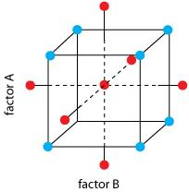
Design of Experiments (DOE)

Slide 3
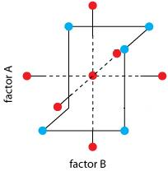
Design of Experiments (DOE)

Slide 4


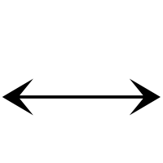


DOE for Synthetic Biology
Biological
Design
Design of Experiments
Experimental
Data

Slide 5










Clotho 3.0
Databases
Data
Clotho Web Client
Widgets
Schemas
Converters
Scripts
Database
Clotho-Aware Apps

Slide 6
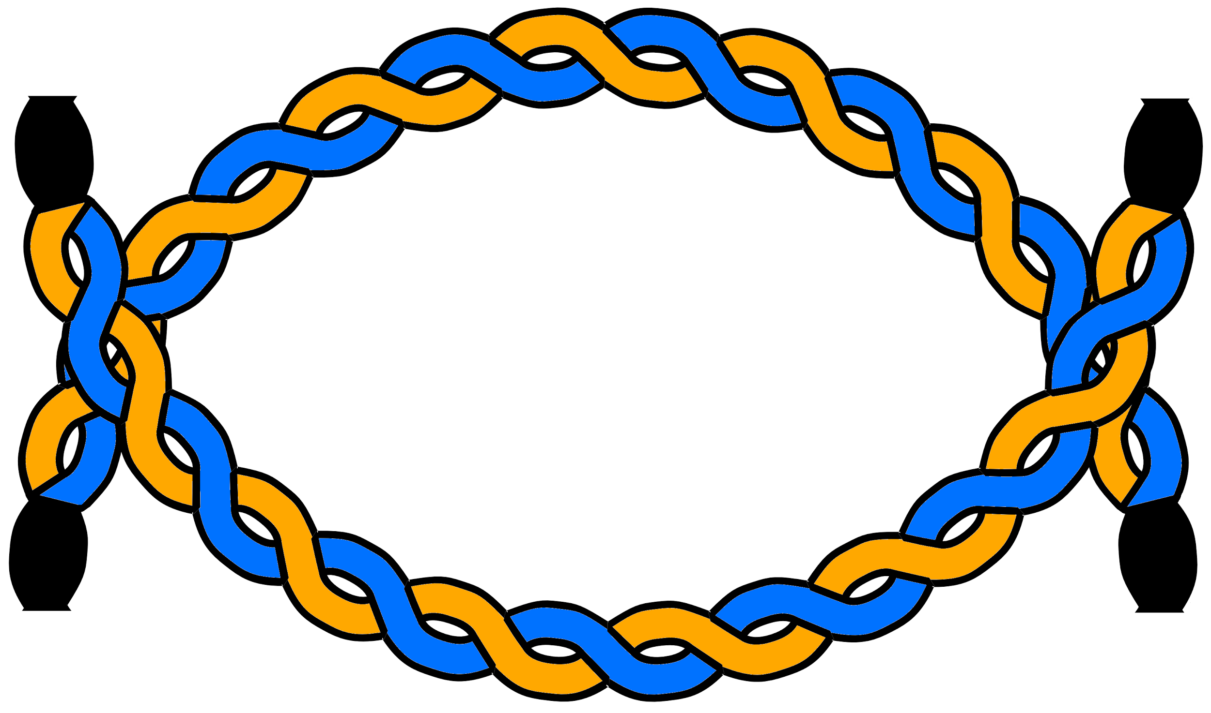
DOE for Synthetic Biology w/ Double Dutch
Design of Experiments
Biological
Design
Double Dutch

Slide 7
Talk Outline
Overview of Double Dutch web app
Double Dutch demo
Discussion of app extensions

Slide 8
Step 1: Import Features
Feature

Slide 9



Step 1: Import Features
ATCGA
GGCTA
GCTAA
ATTCA

Slide 10
Step 2: Infer Modules
Module
Feature

Slide 11
Step 2: Infer Modules
Transcription
Expression
Translation

Slide 12
Step 3: Parameterize Modules
Design
Module
Parameter
Feature

Slide 13
Step 3: Parameterize Module
10356 REU
Transcription
Expression
Translation
2.89 REU

Slide 14
Step 4: Categorize as Factors or Levels
Available Factors
Available Levels
10356 REU
Expression
Transcription
Translation
2.89 REU

Slide 15
Step 5: Assign Levels to Factors
Factor
Level

Slide 16
Step 5a: Choose # of Levels per Factor
Factor
High
Medium
Low

Slide 17
Step 5b: Quantify Target Levels
Factor
20159
1943
236

Slide 18
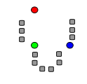
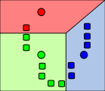
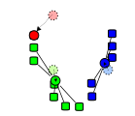
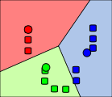
K-Means Clustering

Slide 19
Step 5c: Partition Level Choices
20159
28965
24566
18777
23489
1943
2123
2230
1854
2176
236
478
357
125
298

Slide 20
Step 5d: Score Level Choices
20159
28965
24566
18777
23489
1943
2123
2230
1854
2176
Score = |Target - Choice|
236
478
357
125
298

Slide 21
Step 5d: Score Level Choices
20159
8806
4407
1382
3330
1943
180
287
89
233
Score = |Target - Choice|
236
242
121
111
62

Slide 22
Step 5e: Sort Level Choices
1382
3330
4407
8806
89
180
233
287
62
111
121
242

Slide 23
Step 5f: Greedy Search
1382
3330
4407
8806
1382
3330
4407
8806
89
180
233
287
89
180
233
287
62
111
121
242
62
111
121
242

Slide 24
Step 5f: Greedy Search
1382
3330
4407
8806
1382
3330
4407
8806
89
180
233
287
89
180
233
287
62
111
121
242
62
111
121
242

Slide 25
Step 5f: Greedy Search
1382
3330
4407
8806
1382
3330
4407
8806
89
180
233
287
89
180
233
287
62
111
121
242
62
111
121
242

Slide 26
Step 5f: Greedy Search
1382
3330
4407
8806
1382
3330
4407
8806
89
180
233
287
89
180
233
287
62
111
121
242
62
111
121
242

Slide 27
Step 5f: Greedy Search
1382
3330
4407
8806
1382
3330
4407
8806
89
180
233
287
89
180
233
287
62
111
121
242
62
111
121
242

Slide 28
Step 5f: Greedy Search
1382
3330
4407
8806
1382
3330
4407
8806
89
180
233
287
89
180
233
287
62
111
121
242
62
111
121
242

Slide 29
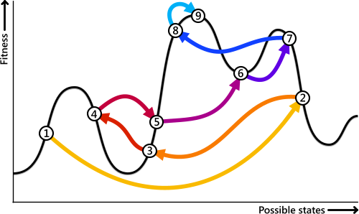
Local Optimum and Simulated Annealing

Slide 30
Step 5g: Simulated Annealing
1382
3330
4407
8806
1382
3330
4407
8806
89
180
233
287
89
180
233
287
62
111
121
242
62
111
121
242

Slide 31
Step 5g: Simulated Annealing
1382
3330
4407
8806
1382
3330
4407
8806
89
180
233
287
89
180
233
287
62
111
121
242
62
111
121
242

Slide 32
Step 5g: Simulated Annealing
1382
3330
4407
8806
1382
3330
4407
8806
89
180
233
287
89
180
233
287
62
111
121
242
62
111
121
242

Slide 33
Step 5g: Simulated Annealing
1382
3330
4407
8806
1382
3330
4407
8806
89
180
233
287
89
180
233
287
62
111
121
242
62
111
121
242

Slide 34
Step 5g: Simulated Annealing
1382
3330
4407
8806
89
180
233
287
P(accept) = e^[(oldScore - newScore)/Temp]
62
111
121
242

Slide 35
Step 5g: Simulated Annealing
1382
3330
4407
8806
89
180
233
287
P(accept) = e^[(oldScore - newScore)/Temp]
62
111
121
242

Slide 36
Simulated Annealing

Slide 37
Step 6: Generate Experimental Design
Experimental Design
Factor
Level

Slide 38
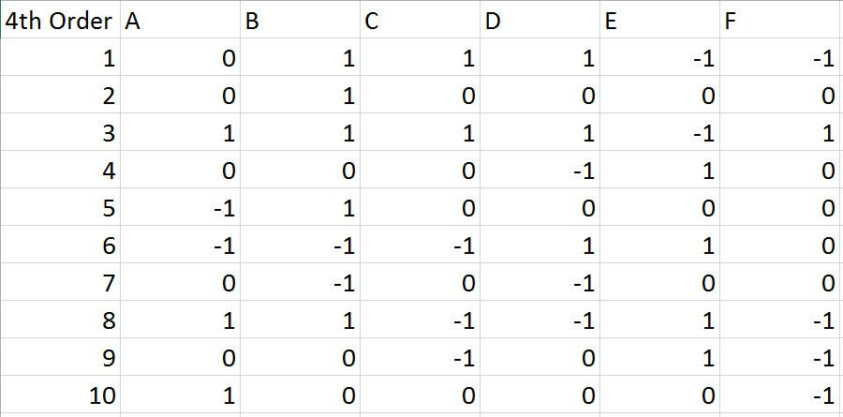
Step 6: Generate Experimental Design

Slide 39
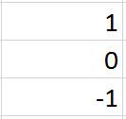
Step 6: Generate Experimental Design
20159
1943
236

Slide 40
Step 6: Generate Experimental Design
Factor
Factor
8806
1382
287
233
62
121

Slide 41
Step 6: Generate Experimental Design
Factor
Factor
8806
1382
287
233
62
121

Slide 42



Step 7: Generate Biological Designs
Expression
Expression
Transcription
Transcription
Expression
Expression

Slide 43
Planned Extensions
Validate composition of modules associated with factors and levels in experimental designs.
Fit empirical models to experimental data.
Incorporate Pigeon for design visualization.
Export designs in additional file formats (Euegene, SBOL, JSON).
Generate picklists for automated assembly.

Slide 44






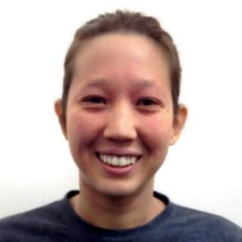






Clotho Team
Douglas
Densmore
J. Christopher
Anderson
Stephanie
Paige
Prashant
Vaidyanathan
Bill
Cao
Maxwell
Bates

